Slide 1
Sponsor Agreement
Sponsor Insertion Order
Selling
SplashPlay
SESSON 1
November 30, 2016
Game Demonstration

Slide 2
SESSON 1
Customer Paperwork
Game Sponsor Agreement
Notes:
Slide 1
Hello. I’m Thomas Banks the founder and CEO of SplashPlay, the provider of the most innovative way to empower your organization’s marketing and customer engagement efforts. Gamification.

Slide 3
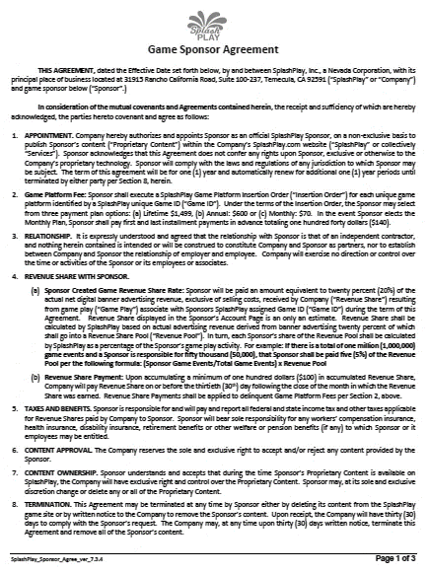
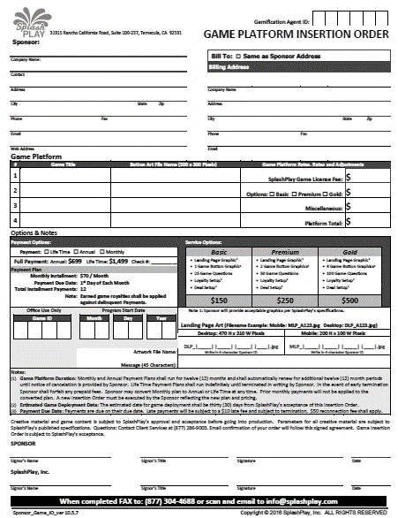
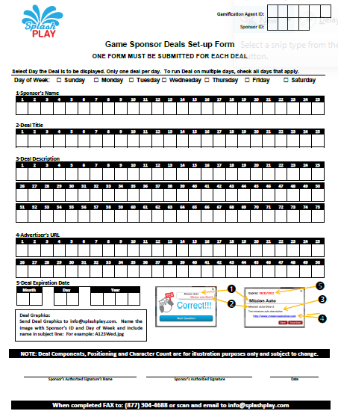
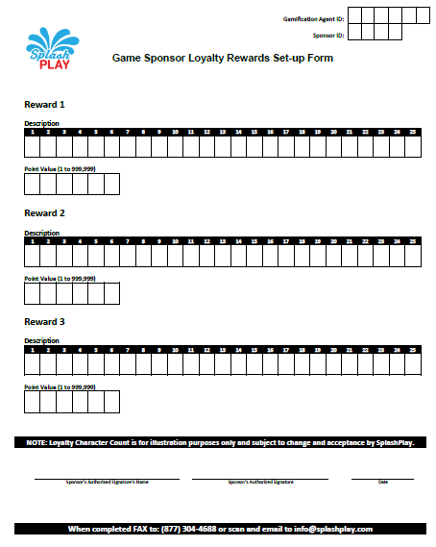
SplashPlay Documents
Sponsor Agreement
Insertion Order
Deal Setup Form
A SplashPlay Order is
Comprised of Two Sets of Documents
Loyalty Setup Form
Notes:
Slide 3
New customer acquisition, effectively engaging existing customers, provide better value to customers, stimulate social media engagement, provide a mechanism for affordable delivery of offers and deals, achieve a competitive advantage and stimulate customer loyalty.
Click
Certainly all worthy objectives. But, naturally begs two relevant questions: One, is all this achieved? And Two, at what cost?
SplashPlay not only is unique in its approach to gaming, it is equally unique in its approach to business. The answers to these two questions are
Click
Mobile gaming and at no cost.
That’s right. No cost. Indulge me for a few minutes as I share with you a truly interesting and unique approach to marketing. Mobile Gamification.

Slide 4
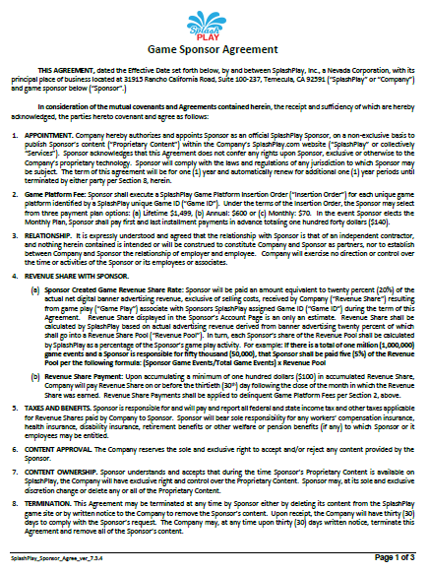
Game Sponsor Agreement
Purpose and Requirements
Three Page Agreement
Defines terms & conditions between Sponsor and SplashPlay.
Who Must Sign a Sponsor Agreement?
Every Sponsor.
When does a Sponsor need a new Sponsor Agreement?
Initial Order
New Entity
Notes:
Slide 3
New customer acquisition, effectively engaging existing customers, provide better value to customers, stimulate social media engagement, provide a mechanism for affordable delivery of offers and deals, achieve a competitive advantage and stimulate customer loyalty.
Click
Certainly all worthy objectives. But, naturally begs two relevant questions: One, is all this achieved? And Two, at what cost?
SplashPlay not only is unique in its approach to gaming, it is equally unique in its approach to business. The answers to these two questions are
Click
Mobile gaming and at no cost.
That’s right. No cost. Indulge me for a few minutes as I share with you a truly interesting and unique approach to marketing. Mobile Gamification.

Slide 5
Game Sponsor Agreement
Section 1: Appointment
Authorizes Organization as a Sponsor to use SplashPlay’s proprietary technology
Section 2: Platform Fee
Defines the Sponsor’s License Fee Options
Section 3: Relationship
Specifies nature of relationship between SplashPlay and Sponsor:
Independent Contractor
Notes:
Slide 3
New customer acquisition, effectively engaging existing customers, provide better value to customers, stimulate social media engagement, provide a mechanism for affordable delivery of offers and deals, achieve a competitive advantage and stimulate customer loyalty.
Click
Certainly all worthy objectives. But, naturally begs two relevant questions: One, is all this achieved? And Two, at what cost?
SplashPlay not only is unique in its approach to gaming, it is equally unique in its approach to business. The answers to these two questions are
Click
Mobile gaming and at no cost.
That’s right. No cost. Indulge me for a few minutes as I share with you a truly interesting and unique approach to marketing. Mobile Gamification.

Slide 6
Game Sponsor Agreement
Section 4: Revenue Share
Section (a): How Revenue Share is determined
Revenue Share:
20% of Gross Banner Advertising Revenue
Revenue Share Pool:
Sum of all Banner Advertising Dollars x 20%
Share of Revenue Share Pool Formula:
Sponsor’s Game Play Events
8.3% =
500,000 Q&As
Sponsor’s Share % =
Total Game Play Events
6,000,000 Q&As
Revenue Share Pool
X
8.3%
$50,000
X
8.3% =
$4,150
Notes:
Slide 3
New customer acquisition, effectively engaging existing customers, provide better value to customers, stimulate social media engagement, provide a mechanism for affordable delivery of offers and deals, achieve a competitive advantage and stimulate customer loyalty.
Click
Certainly all worthy objectives. But, naturally begs two relevant questions: One, is all this achieved? And Two, at what cost?
SplashPlay not only is unique in its approach to gaming, it is equally unique in its approach to business. The answers to these two questions are
Click
Mobile gaming and at no cost.
That’s right. No cost. Indulge me for a few minutes as I share with you a truly interesting and unique approach to marketing. Mobile Gamification.

Slide 7
Game Sponsor Agreement
Section 4: Revenue Share
Section (b): Revenue Share Payment
Payment Minimum: $100
When Paid:
On or before 30th day of Month following month in which Revenue Share was earned.
Section 5: Taxes and Benefits
Sponsor is responsible for all tax obligations.
Federal Taxes
Workers Compensation
Notes:
Slide 3
New customer acquisition, effectively engaging existing customers, provide better value to customers, stimulate social media engagement, provide a mechanism for affordable delivery of offers and deals, achieve a competitive advantage and stimulate customer loyalty.
Click
Certainly all worthy objectives. But, naturally begs two relevant questions: One, is all this achieved? And Two, at what cost?
SplashPlay not only is unique in its approach to gaming, it is equally unique in its approach to business. The answers to these two questions are
Click
Mobile gaming and at no cost.
That’s right. No cost. Indulge me for a few minutes as I share with you a truly interesting and unique approach to marketing. Mobile Gamification.

Slide 8
Game Sponsor Agreement
Section 6: Content Approval
SplashPlay has sole right to reject any content it deems inappropriate.
Section 7: Content Ownership
During term of Agreement:
SplashPlay has the right to display Sponsor’s Content
Notes:
Slide 3
New customer acquisition, effectively engaging existing customers, provide better value to customers, stimulate social media engagement, provide a mechanism for affordable delivery of offers and deals, achieve a competitive advantage and stimulate customer loyalty.
Click
Certainly all worthy objectives. But, naturally begs two relevant questions: One, is all this achieved? And Two, at what cost?
SplashPlay not only is unique in its approach to gaming, it is equally unique in its approach to business. The answers to these two questions are
Click
Mobile gaming and at no cost.
That’s right. No cost. Indulge me for a few minutes as I share with you a truly interesting and unique approach to marketing. Mobile Gamification.

Slide 9
Game Sponsor Agreement
Section 8: Termination
Sponsor may terminate at any time.
Option 1: Delete content from SplashPlay
Option 2: Issue 30-day written notice
SplashPlay may terminate without cause with 30-day written notice.
Section 9: Announcements
Sponsor and SplashPlay may issue announcements without prior approval of the other party.
Notes:
Slide 3
New customer acquisition, effectively engaging existing customers, provide better value to customers, stimulate social media engagement, provide a mechanism for affordable delivery of offers and deals, achieve a competitive advantage and stimulate customer loyalty.
Click
Certainly all worthy objectives. But, naturally begs two relevant questions: One, is all this achieved? And Two, at what cost?
SplashPlay not only is unique in its approach to gaming, it is equally unique in its approach to business. The answers to these two questions are
Click
Mobile gaming and at no cost.
That’s right. No cost. Indulge me for a few minutes as I share with you a truly interesting and unique approach to marketing. Mobile Gamification.

Slide 10
Game Sponsor Agreement
Section 10: Content & Marketing Material
Sponsor shall…
Provide Copy, Compatible Artwork and any material necessary for SplashPlay to provide its services.
Represent and warrant that it has the right to publish content.
Authorize SplashPlay to use Sponsor’s its name, logo, trademarks, etc. is providing SplashPlay services.
SplashPlay shall…
Bear all costs of providing its services.
Determine placement of Sponsor’s game.
Notes:
Slide 3
New customer acquisition, effectively engaging existing customers, provide better value to customers, stimulate social media engagement, provide a mechanism for affordable delivery of offers and deals, achieve a competitive advantage and stimulate customer loyalty.
Click
Certainly all worthy objectives. But, naturally begs two relevant questions: One, is all this achieved? And Two, at what cost?
SplashPlay not only is unique in its approach to gaming, it is equally unique in its approach to business. The answers to these two questions are
Click
Mobile gaming and at no cost.
That’s right. No cost. Indulge me for a few minutes as I share with you a truly interesting and unique approach to marketing. Mobile Gamification.

Slide 11
Game Sponsor Agreement
Section 11: Links
Sponsor shall provide links on its website, emails, multimedia and social media per SplashPlay’s specifications.
Section 12: Modifications
SplashPlay reserves the right to change the terms of the Agreement upon renewal
Any changes will not effect any terms and conditions in effect prior to subsequent changes.
For example: Any change in Revenue Share Percentage will not effect existing Sponsors.
Notes:
Slide 3
New customer acquisition, effectively engaging existing customers, provide better value to customers, stimulate social media engagement, provide a mechanism for affordable delivery of offers and deals, achieve a competitive advantage and stimulate customer loyalty.
Click
Certainly all worthy objectives. But, naturally begs two relevant questions: One, is all this achieved? And Two, at what cost?
SplashPlay not only is unique in its approach to gaming, it is equally unique in its approach to business. The answers to these two questions are
Click
Mobile gaming and at no cost.
That’s right. No cost. Indulge me for a few minutes as I share with you a truly interesting and unique approach to marketing. Mobile Gamification.

Slide 12
Game Sponsor Agreement
Section 13: Suggestions, Comments, etc.
Any suggestions, comments or feedback becomes the property of SplashPlay and not subject to compensation.
Section 14: No License
Sponsor is granted a license to use SplashPlay’s service
Sponsor is not granted a license or any right to SplashPlay's technology, trademarks, patents or intellectual property.
Section 15: Assignment
Sponsor may not assign the Agreement or its Revenue Share without SplashPlay’s written approval.
Notes:
Slide 3
New customer acquisition, effectively engaging existing customers, provide better value to customers, stimulate social media engagement, provide a mechanism for affordable delivery of offers and deals, achieve a competitive advantage and stimulate customer loyalty.
Click
Certainly all worthy objectives. But, naturally begs two relevant questions: One, is all this achieved? And Two, at what cost?
SplashPlay not only is unique in its approach to gaming, it is equally unique in its approach to business. The answers to these two questions are
Click
Mobile gaming and at no cost.
That’s right. No cost. Indulge me for a few minutes as I share with you a truly interesting and unique approach to marketing. Mobile Gamification.

Slide 13
Game Sponsor Agreement
General Legal Terms and Conditions
16) Waiver: Failure to uphold any provision does not waive any other provisions.
17) Notice: Valid notices are delivered in person, postal service or in SplashPlay’s case, published on its website.
18) Jurisdiction: State of California, County of Riverside.
19) Arbitration: Parties agree to arbitrate all disputes.
20) Arbitration Costs and Attorney Fees: Prevailing party shall be awarded its costs.
21) Force Majeure: Company is not liable for failure to perform for reasons outside its control (e.g. acts of God)
22) Captions: Captions are for convenience only.
23) Severability: Any section determined to be invalid does not invalidate the entire Agreement.
24) Modifications: Only valid if approved by SplashPlay
25) Entire Agreement: The Agreement contains all terms and conditions. There are no outside agreements either written or verbal other than this Agreement.
Notes:
Slide 3
New customer acquisition, effectively engaging existing customers, provide better value to customers, stimulate social media engagement, provide a mechanism for affordable delivery of offers and deals, achieve a competitive advantage and stimulate customer loyalty.
Click
Certainly all worthy objectives. But, naturally begs two relevant questions: One, is all this achieved? And Two, at what cost?
SplashPlay not only is unique in its approach to gaming, it is equally unique in its approach to business. The answers to these two questions are
Click
Mobile gaming and at no cost.
That’s right. No cost. Indulge me for a few minutes as I share with you a truly interesting and unique approach to marketing. Mobile Gamification.

Slide 14
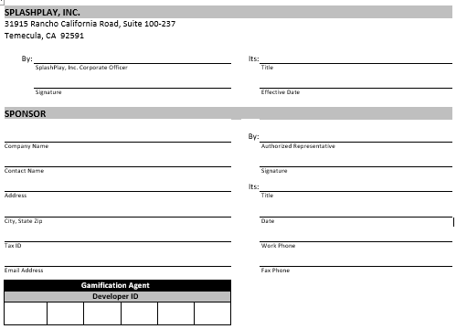
Game Sponsor Agreement
Executing the Agreement
Completed by SplashPlay
Completed by Gamification Agent or Sponsor
Signed by Sponsor
Completed by SplashPlay’s
Gamification Agent
Enter SplashPlay Assigned Agent ID
Menu
Notes:
Slide 3
New customer acquisition, effectively engaging existing customers, provide better value to customers, stimulate social media engagement, provide a mechanism for affordable delivery of offers and deals, achieve a competitive advantage and stimulate customer loyalty.
Click
Certainly all worthy objectives. But, naturally begs two relevant questions: One, is all this achieved? And Two, at what cost?
SplashPlay not only is unique in its approach to gaming, it is equally unique in its approach to business. The answers to these two questions are
Click
Mobile gaming and at no cost.
That’s right. No cost. Indulge me for a few minutes as I share with you a truly interesting and unique approach to marketing. Mobile Gamification.

Slide 15
SESSON 1
Customer Paperwork
Insertion Order
Notes:
Slide 1
Hello. I’m Thomas Banks the founder and CEO of SplashPlay, the provider of the most innovative way to empower your organization’s marketing and customer engagement efforts. Gamification.

Slide 16
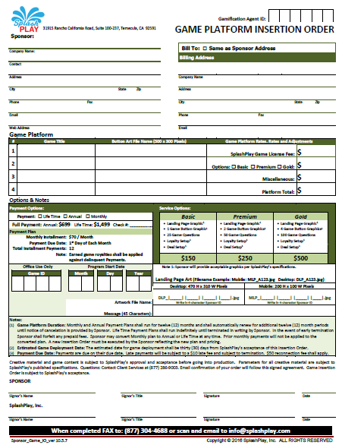
Game Insertion Order
Purpose
Defines the terms of the Sponsor’s game
Game Title and Button Art
Monthly, Annual or Life-Time
When is an Insertion Order needed?
Initial Order
Purchase of Service Options
Change of License Type
If Sponsor desires additional games
Notes:
Slide 3
New customer acquisition, effectively engaging existing customers, provide better value to customers, stimulate social media engagement, provide a mechanism for affordable delivery of offers and deals, achieve a competitive advantage and stimulate customer loyalty.
Click
Certainly all worthy objectives. But, naturally begs two relevant questions: One, is all this achieved? And Two, at what cost?
SplashPlay not only is unique in its approach to gaming, it is equally unique in its approach to business. The answers to these two questions are
Click
Mobile gaming and at no cost.
That’s right. No cost. Indulge me for a few minutes as I share with you a truly interesting and unique approach to marketing. Mobile Gamification.

Slide 17
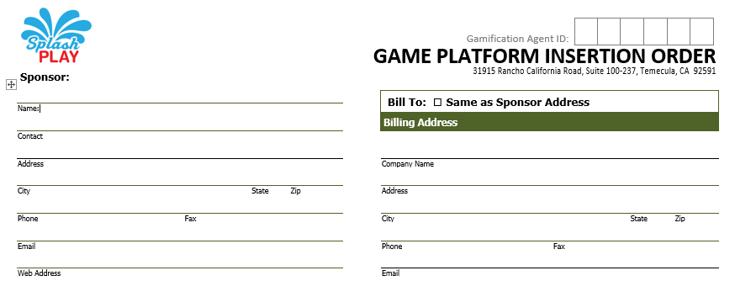
Game Insertion Order
Completing the Insertion Order
Enter SplashPlay Agent ID
Sponsor Business Address
Sponsor Billing
Notes:
Slide 3
New customer acquisition, effectively engaging existing customers, provide better value to customers, stimulate social media engagement, provide a mechanism for affordable delivery of offers and deals, achieve a competitive advantage and stimulate customer loyalty.
Click
Certainly all worthy objectives. But, naturally begs two relevant questions: One, is all this achieved? And Two, at what cost?
SplashPlay not only is unique in its approach to gaming, it is equally unique in its approach to business. The answers to these two questions are
Click
Mobile gaming and at no cost.
That’s right. No cost. Indulge me for a few minutes as I share with you a truly interesting and unique approach to marketing. Mobile Gamification.

Slide 18
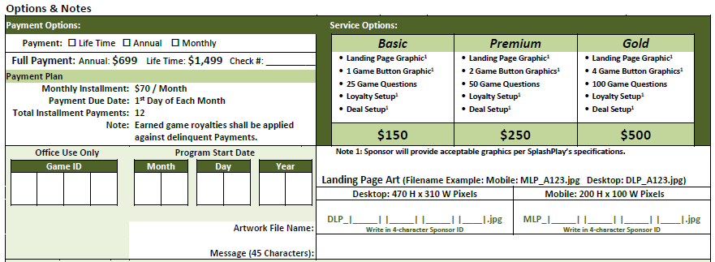
Game Insertion Order
Completing the Insertion Order
Sponsor Plan Options
Additional Service Options
Completed by SplashPlay
Landing Page Artwork
Notes:
Slide 3
New customer acquisition, effectively engaging existing customers, provide better value to customers, stimulate social media engagement, provide a mechanism for affordable delivery of offers and deals, achieve a competitive advantage and stimulate customer loyalty.
Click
Certainly all worthy objectives. But, naturally begs two relevant questions: One, is all this achieved? And Two, at what cost?
SplashPlay not only is unique in its approach to gaming, it is equally unique in its approach to business. The answers to these two questions are
Click
Mobile gaming and at no cost.
That’s right. No cost. Indulge me for a few minutes as I share with you a truly interesting and unique approach to marketing. Mobile Gamification.

Slide 19
Game Insertion Order
Completing the Insertion Order
Game Title
Game Button Artwork
Itemized Fees
Notes:
Slide 3
New customer acquisition, effectively engaging existing customers, provide better value to customers, stimulate social media engagement, provide a mechanism for affordable delivery of offers and deals, achieve a competitive advantage and stimulate customer loyalty.
Click
Certainly all worthy objectives. But, naturally begs two relevant questions: One, is all this achieved? And Two, at what cost?
SplashPlay not only is unique in its approach to gaming, it is equally unique in its approach to business. The answers to these two questions are
Click
Mobile gaming and at no cost.
That’s right. No cost. Indulge me for a few minutes as I share with you a truly interesting and unique approach to marketing. Mobile Gamification.

Slide 20
Game Insertion Order
Completing the Insertion Order
Completed by Sponsor
Completed by SplashPlay
Notes:
Slide 3
New customer acquisition, effectively engaging existing customers, provide better value to customers, stimulate social media engagement, provide a mechanism for affordable delivery of offers and deals, achieve a competitive advantage and stimulate customer loyalty.
Click
Certainly all worthy objectives. But, naturally begs two relevant questions: One, is all this achieved? And Two, at what cost?
SplashPlay not only is unique in its approach to gaming, it is equally unique in its approach to business. The answers to these two questions are
Click
Mobile gaming and at no cost.
That’s right. No cost. Indulge me for a few minutes as I share with you a truly interesting and unique approach to marketing. Mobile Gamification.

Slide 21
Game Insertion Order
Setting Up Deals
Deal Delivery Schedule
Only one deal per day
Select all days deal is to be delivered
Select between 1 and 7 days
Enter Agent ID Number
Enter Sponsor Number if known
Enter Sponsor’s Name
Deal’s Title
Deal’s Description
Deal’s “Shortened” URL
www.bitly.com
Deal Graphics
300 x 300 Pixels
Low Resolution JPG File
Naming Convention:
Sponsor # + Day.jpg
A123WED.jpg
Deal’s Expiration Date
Signed by Sponsor
Notes:
Slide 3
New customer acquisition, effectively engaging existing customers, provide better value to customers, stimulate social media engagement, provide a mechanism for affordable delivery of offers and deals, achieve a competitive advantage and stimulate customer loyalty.
Click
Certainly all worthy objectives. But, naturally begs two relevant questions: One, is all this achieved? And Two, at what cost?
SplashPlay not only is unique in its approach to gaming, it is equally unique in its approach to business. The answers to these two questions are
Click
Mobile gaming and at no cost.
That’s right. No cost. Indulge me for a few minutes as I share with you a truly interesting and unique approach to marketing. Mobile Gamification.

Slide 22
Game Insertion Order
Loyalty Program
Enter Agent ID Number
Enter Sponsor Number if known
Loyalty Description
Point Value
1 to 999,999
Signed by Sponsor
Menu
Notes:
Slide 3
New customer acquisition, effectively engaging existing customers, provide better value to customers, stimulate social media engagement, provide a mechanism for affordable delivery of offers and deals, achieve a competitive advantage and stimulate customer loyalty.
Click
Certainly all worthy objectives. But, naturally begs two relevant questions: One, is all this achieved? And Two, at what cost?
SplashPlay not only is unique in its approach to gaming, it is equally unique in its approach to business. The answers to these two questions are
Click
Mobile gaming and at no cost.
That’s right. No cost. Indulge me for a few minutes as I share with you a truly interesting and unique approach to marketing. Mobile Gamification.

Slide 23
SESSON 1
Selling SplashPlay

Slide 24
Selling SplashPlay
Features & Benefits
FEATURES
Branding
•
Loyalty
•
Messaging
•
Education
BENEFITS
Engagement
•
Social Media
•
Low Cost
•
Differentiation

Slide 25
Selling SplashPlay
Cold Calling Facts
12%
Quit after 4 rejections
44%
Quit after 1 rejection
14%
Quit after 3 rejections
66%
Quit after 2 rejections
22%
Quit after 2 rejections
On Average, it takes 7 Attempts to contact a Decision Maker

Slide 26
Selling SplashPlay
SplashPlay’s Success Process
Ideal Customers
Build Your List
Sell the Dream
Close the Deal
IDEAL
PROFILE
Interesting Content
•
Social Media Awareness
•
Willingness to Embrace Gaming
LOW-HANGING FRUIT
Who You Know
•
Referrals
•
Previous Clients
SOLUTION SELLING
Show SplashPlay Video
“Gamify Your Business”
•
Connect Customer’s Needs to SplashPlay’s Unique Solution
THE
CLOSING
Sign Agreement
•
Complete Insertion Order
•
Collect Check
•
Provide Quick Start Guide
•
Ask for Referrals
IDEAL CUSTOMERS:
Veterinarians
Memorabilia
Sporting Goods
Museums
Galleries
Restaurants
Authors
Athletes
Artists
Entertainers
Parks/Zoos
CUSTOMERS’ NEEDS:
Affordability
Social Media Reach
Business Growth
Engaged Customers
Increased Loyalty
Message Delivery

Slide 27
Selling SplashPlay
Frequently Asked Questions
Why doesn’t SplashPlay accept Credit Cards?
We believe Internet and network sales cause people to be concerned about credit card fraud.
People forget, Credit Cards expire and Credit Card limits are exceeded. Overall, we believe our billing eliminates confusion and lowers administration cost.
Eliminates potential for charge disputes. All of which are costly to address and always result in refunds. With credit cards, the cardholder always wins a dispute.

Slide 28
Selling SplashPlay
Frequently Asked Questions
Can I sell anywhere?
Yes. SplashPlay doesn’t impose any geographic limitations or provide exclusive territories.

Slide 29
Selling SplashPlay
Frequently Asked Questions
What if someone I recruit, recruits another SplashPlay agent. How am I compensated?
YOUR COMPENSATION
40%
Licenses
+
25%
Services
+
25%
Banner Ad Override
+
25%
Agent Override
Sub-Agent Gross Commission
40%
Licenses
25%
Services
25%
Banner Ad Override
25%
Agent Override

Slide 30
Selling SplashPlay
Frequently Asked Questions
How much can I make?
Scenario 1:
Single Month Analysis | Qty | Sales | Commission
New Monthly Contracts | 6 | $420 | $168
New Annual Contracts | 2 | $1,398 | $559
New Life-Time Contracts | 1 | $1,499 | $599
Services |  | $1,000 | $250
Totals | 9 | $4,317 | $1,576

Slide 31
Selling SplashPlay
Frequently Asked Questions
Scenario 2:
Single Month Analysis | Qty | Sales | Commission
New Monthly Contracts | 12 | $840 | $336
New Annual Contracts | 4 | $2,796 | $1,118
New Life-Time Contracts | 2 | $2,998 | $1,199
Services |  | $2,000 | $500
Totals | 18 | $8,634 | $3,153

Slide 32
Selling SplashPlay
Frequently Asked Questions
Scenario 3: Build a 10 Member Team
Team Sales | Qty | Sales | Commission
New Monthly Contracts | 12 | $840 | $336
New Annual Contracts | 4 | $2,796 | $1,118
New Life-Time Contracts | 2 | $2,998 | $1,199
Services |  | $2,000 | $500
Totals | 18 | $8,634 | $3,153
Total Agent Team Commission |  |  | $31,530
Your Team Override (25%) |  |  | $7,883
Your Direct Sales Commission (Scenario 2) |  |  | $3,153
Total Personal Commission |  |  | $11,036

Slide 33
Selling SplashPlay
Frequently Asked Questions
How much can I make?
Before we complete the analysis on commissions. Note the following:
This analysis is limited to direct sales. Banner ad override will be explored later.
Monthly License Sales are cumulative. That is…
Month 1 Month 2 Month 3
Unit Sales 5 5 5
Cumulative Sales 5 10 15
Revenue ($70 each) $350 $700 $1,050
Commission $140 $280 $420

Slide 34
Selling SplashPlay
Frequently Asked Questions
Scenario 3: 12 Months / 10 Member Team
Twelve Month Analysis | Qty | Sales | Commission
Total Monthly Contract Months | 4,680 | $327,600 | $131,040
Total Annual Contracts | 480 | $335,520 | $134,208
Total Life-Time Contracts | 240 | $359,760 | $143,904
Total Services |  | $240,000 | $60,000
Total Agent Team Commissions |  |  | $469,152
Average Individual Agent Commission |  |  | $46,915
Your Team Override (25%) |  |  | $117,288
Your Direct Sales Commission (Scenario 2) |  |  | $46,915
Total Personal Commission |  |  | $164,203
Menu

Slide 35
The End
Notes:
Slide 1
Hello. I’m Thomas Banks the founder and CEO of SplashPlay, the provider of the most innovative way to empower your organization’s marketing and customer engagement efforts. Gamification.

